Slide 1
TDI: Julia
Get started on Julia Programming
William Mui

Slide 2
Julia REPL
(Read–eval–print loop)

Slide 3
Julia REPL
In Julia REPL interactive session, the command line will repeatedly
takes single user inputs (i.e., single expressions)
evaluates (executes) them
returns the result to the user
To start a new interactive session, Type “julia” in command-line prompt or double-clicking the Julia executable)
To quit the session,press Ctrl+D

Slide 4
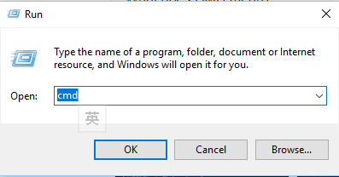
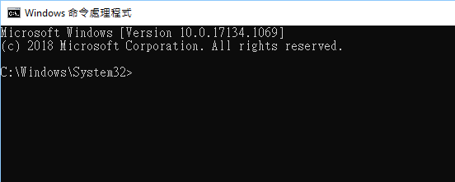
Command prompt
Press Windows button + R
Type cmd and press enter
A new command prompt will be opened
Use “cd <dir>” to change directory

Slide 5

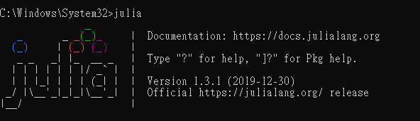
Open Julia REPL
Use cmd and type “julia”
Desktop icon

Slide 6
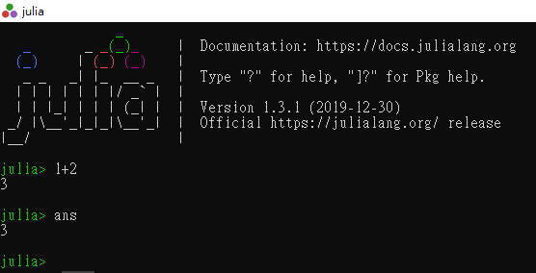
The first interactive session
Steps:
Running julia interactive session
Enter "1+2"
Press enter
Type “ans” and press enter
Expected Result:

Slide 7
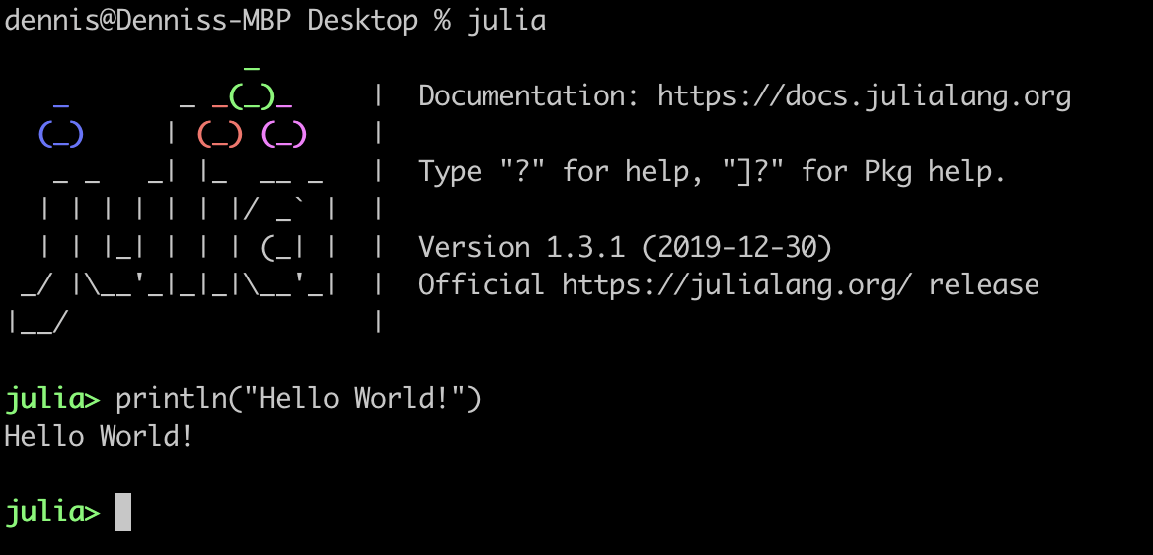
“Hello world” program
“Hello world” program is a very simple program to introduce the syntax and print function.
Steps:
Running julia interactive session
Type “println(“Hello World”)”
Press enter
Expected Result:

Slide 8
Run program from files

Slide 9
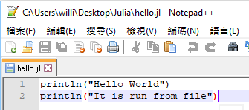
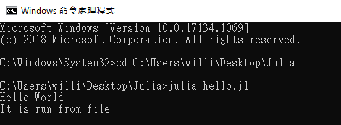
Run program from files
Alternative method to run Julia codes
Store in a file with .jl extension
Execute all in once, according to the sequence in the file
Use new line to separate the expression/statement

Slide 10
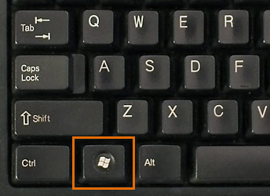
Steps to run program
Prepare the program with .jl extension (source code file)
Press Windows key + R

Slide 11
Steps to run program
3. Type cmd and press enter
4. Use command “cd <path>” and change the directory to your source code file.
5. Type “julia <filename>.jl”

Slide 12
Jupyter Notebook

Slide 13

Jupyter Notebook (REPL)
Jupyter Notebook is a browser-based REPL
Combines code, formatted text, math, and multimedia in a single document
Our tutorial will be provided in Jupyter Notebook

Slide 14
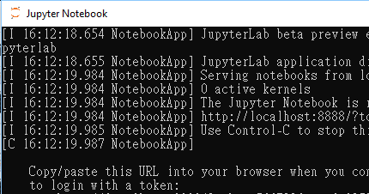
Run codes on Jupyter notebook
Make sure you have already install the notebook and kernel
Launch Jupyter Notebook in your start menu
A command prompt will go out. Do not close it. Just ignore it.

Slide 15
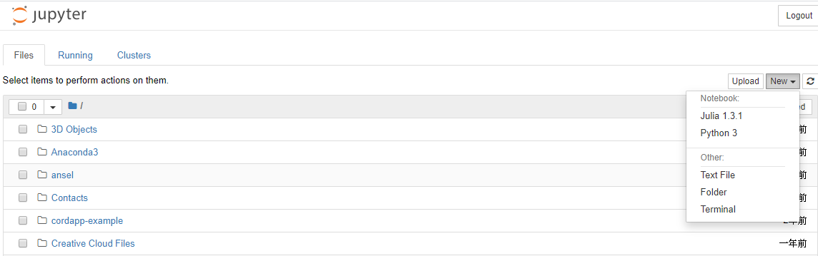
Run codes on Jupyter notebook
4. Go to http://localhost:8888/tree
5. If you are creating a new notebook, press new->Julia. If you would like to open a .ipynb file, select from the list or upload to the list

Slide 16
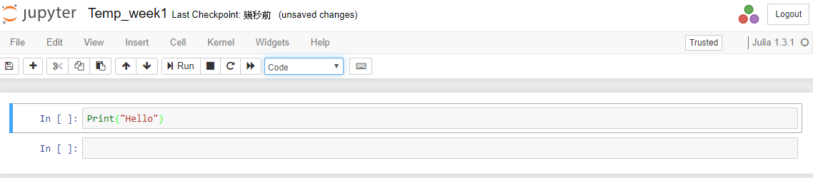
Interface
Filename, double to rename
Cell, can either store code,text and photo

Slide 17
Interface
Restart and run all cells
Save
Add cell
Run the cell
Force Stop
Restart shell
Type of the cell

Slide 18
Julia REPL vs File vs Jupyter Notebook

Slide 19
Julia REPL vs File vs Jupyter Notebook
Julia REPL
Official method to run codes
Enter the expression one-by-one
Interactive, suitable for short program/expression
File
Official method to run codes
Non-interactive, Need to use print function to see the value
Suitable for complex program

Slide 20
Julia REPL vs File vs Jupyter Notebook
Jupyter Notebook
Run the codes with IJulia kernel
Need to install Julia first and install the kernel as a package
Interactive
No need to enter the expression one-by-one
Allows execute one-by-one

Slide 21
Variables, Expressions and Statements

Slide 22
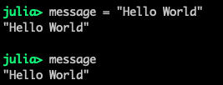
Variables
Store a value for later use
With identifier(name)
Maps the identifier(name) to a value
Example: A variable called message is created

Slide 23
Expressions
Combination of one or more
Constants
Variables
Operators
Example: (a+2)*3

Slide 24
Statements
An instruction for Julia to perform an action
Example: A statement to create(initialize) variable message

Slide 25
Names of Variables

Slide 26
Name of variables
Julia supports using non-english characters(in UTF-8 encoding)
Must begin with a characters or underscore
Some words are reserved and not allowed to be the name of variable
Examples of variable names
Valid | Invalid
abc | !abc
_abc | 123abc
abc!123 | try
δ
안녕하세요abc123!δ

